Slide 1
Algorithms And Design
Arabic Programming Techniques

Slide 2
#002 Time Complexity
Arabic Programming Techniques

Slide 3
Running Time is Affected By
CPU speed
Amount of main memory
Specialized hardware (e.g. graphics card)
Operating system
System configuration (e.g. virtual memory)
Programming language
Algorithm implementation
Other programs
System tasks (e.g. memory management)
…

Slide 4
How we can calculate time ?
Instead of timing an algorithm, count the number of instructions that it performs
The number of instructions can be written as T(n)

Slide 5
Factorial
Algorithm factorial (n)
{
f = 1; //1
if ( n > 0 ) // 1
for (i = 1 to n) //n+1
f = f * i ; //n
return f ; // 1
}
1+1+n+1+n+1 = 2n +4 = T(n)

Slide 6
Factorial complexity
T(n) = n
T(n)
n
n

Slide 7
Types of cases:
Best case
Worst case
Average case

Slide 8
Linear search
Algorithm linearSearch (a, key, n)
{
for (i = 0 to n-1) //n+1
if (a[i ]== key) return i; // n
return -1; //1
} n+1+n+1 = 2n+2 = T(n)
T(n) = number of array element comparisons.
Best case: T(n) = 1
Worst case: T(n) = n

Slide 9
Complexity of the Linear Search Algorithm
T(n) = 1 in the best case.
T(n) = n in the worst case
T(n)
(n)
(1)
n

Slide 10
Growth Rates Compared
 | n=1 | n=2 | n=4 | n=8 | n=16 | n=32
1 | 1 | 1 | 1 | 1 | 1 | 1
log n | 0 | 1 | 2 | 3 | 4 | 5
n | 1 | 2 | 4 | 8 | 16 | 32
nlogn | 0 | 2 | 8 | 24 | 64 | 160
n² | 1 | 4 | 16 | 64 | 256 | 1024
n³ | 1 | 8 | 64 | 512 | 4096 | 32768
2^{n} | 2 | 4 | 16 | 256 | 65536 | 4294967296
n! | 1 | 2 | 24 | 40320 | 20.9T | Don’t ask!

Slide 11
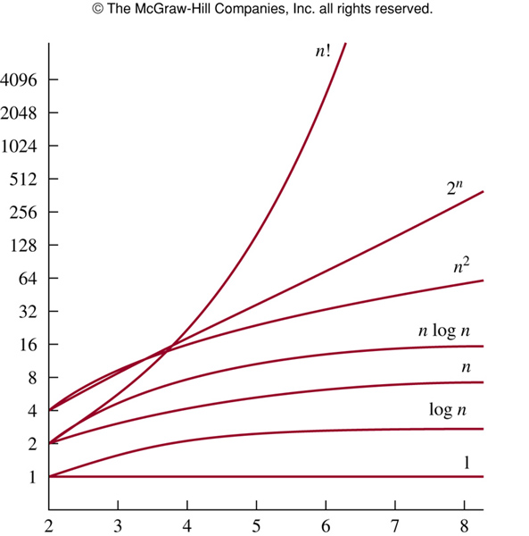
Notes:
p:\msoffice\My Projects\Rosen 6e 2007\Imagebank\JPEGs07-24-06\ch03\jpeg\03-2-003.jpg

Slide 12
Materials
Look at the description
Code and slides will be in my github repo
Dot forget to join the face-book group

Slide 13
Thank you

